Slide 1
Open methods

Slide 2
Fixed Iterative method

Slide 3
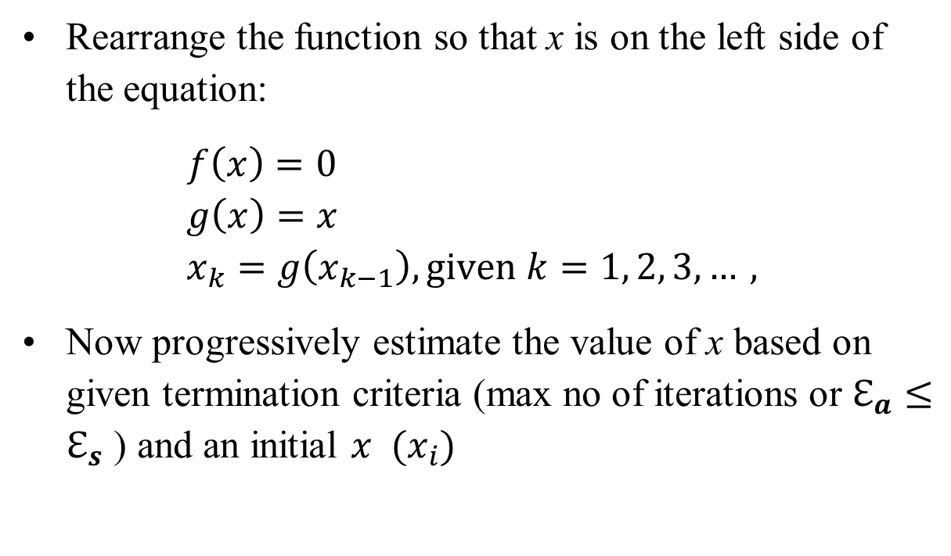
Algorithm: Fixed Iterative Method
Rearrange the function so that x is on the left side of the equation:
$f\left(x\right)=0$ $$g\left(x\right)=x \\ x_{k}=g\left(x_{k−1}\right), \text{given} k=1, 2, 3, …,$$
Now progressively estimate the value of x based on given termination criteria (max no of iterations or $ℇ_{a}≤ℇ_{s}$ ) and an initial $x$ ${ (x}_{i})$

Slide 4

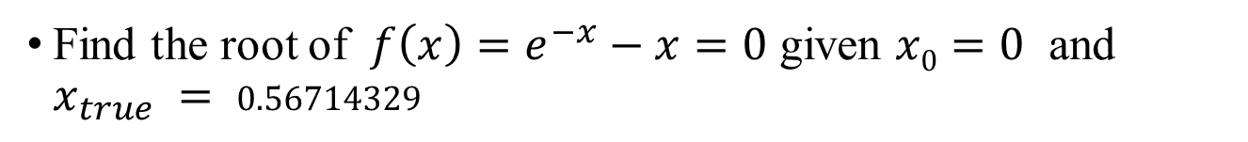
Problem: Fixed Iterative Method
Find the root of $f\left(x\right)=e^{−x}−x=0$ given $x0=0$ and $x_{true} = 0.56714329$
Rearranging the function: $e^{−x}−x=0$
$$x = e^{−x} \\ x_{n+1}=e^{{−x}_{n}}$$

Slide 5
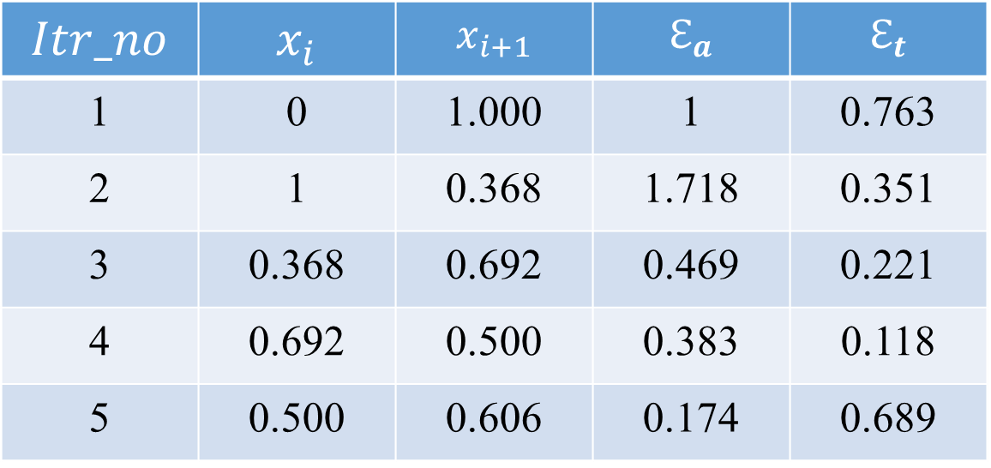
Problem: Fixed Iterative Method
Estimating $x$
$$Itr_no$$ | $$x_{i}$$ | $$x_{i+1}$$ | $$ℇ_{a}$$ | $$ℇ_{t}$$
1 | 0 | 1.000 | 1 | 0.763
2 | 1 | 0.368 | 1.718 | 0.351
3 | 0.368 | 0.692 | 0.469 | 0.221
4 | 0.692 | 0.500 | 0.383 | 0.118
5 | 0.500 | 0.606 | 0.174 | 0.689

Slide 6


Calculating $ℇ_{t}$, True Percent Relative Error
$$ℇ_{t}=\frac{x_{true}−x_{approximate}}{x_{true}}$$
For itr no 1:
$$x_{true}=0.56714329 \\ x_{approximate}=\text{1.000}$$
$$ℇ_{t}=\frac{0.56714329−1}{0.56714329}=0.763$$

Slide 7
Newton-Raphson method

Slide 8
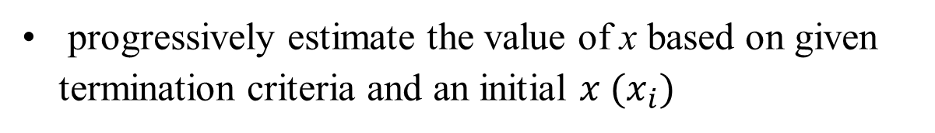

Algorithm: Newton-Raphson method
progressively estimate the value of x based on given termination criteria and an initial $x{ (x}_{i})$
$x_{i+1}= x_{i} − \frac{f(x_{i})}{f^{′}(x_{i})}$

Slide 9

Problem: Newton Raphson Method
Find the root of $f\left(x\right)=e^{−x}−x=0$ given $x0=0$ and $x_{true} = 0.56714329$
$$x_{i+1}= x_{i} − \frac{f\left(x_{i}\right)}{f^{′}\left(x_{i}\right)}$$
$$f\left(x\right)= e^{−x} −x \\ f^{′}\left(x\right) =− e^{−x} −1$$
$$x_{i+1}= x_{i} − \frac{e^{−x_{i}} −x_{i} }{− e^{−x_{i}} −\text{1} }$$

Slide 10
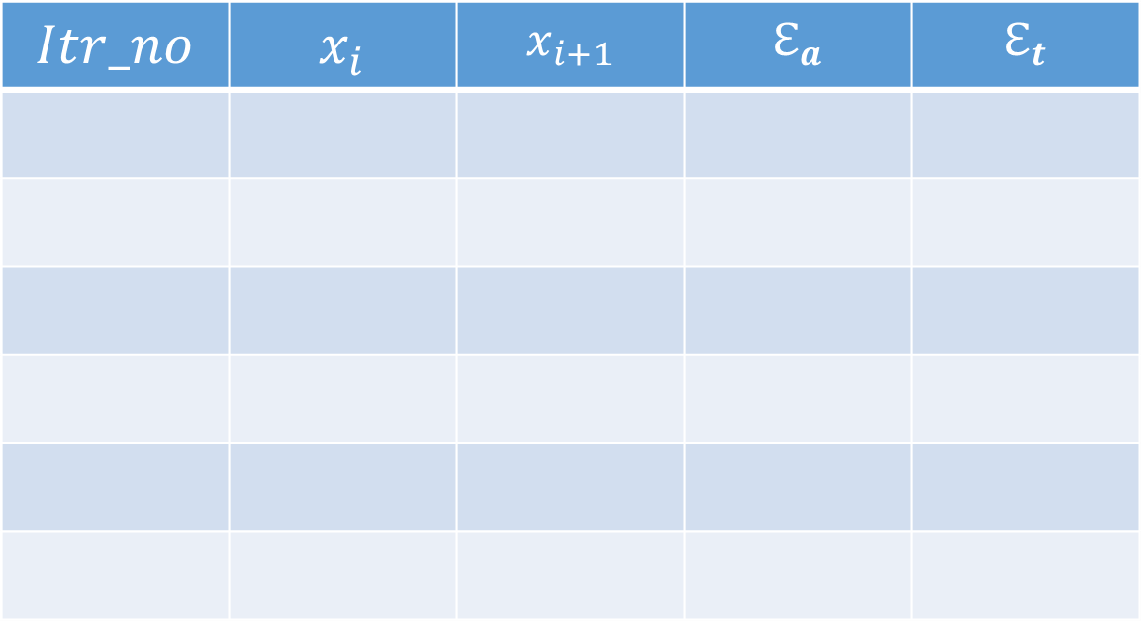
Problem: Newton Raphson Method
Estimating $x$
$$Itr_no$$ | $$x_{i}$$ | $$x_{i+1}$$ | $$ℇ_{a}$$ | $$ℇ_{t}$$

Slide 11
Secant method

Slide 12
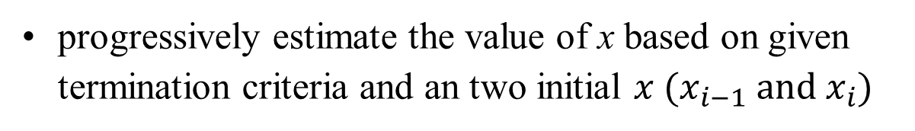
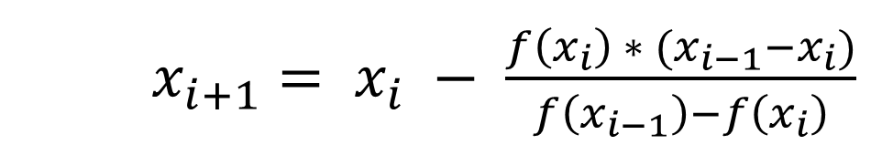
Algorithm: Secant method
progressively estimate the value of x based on given termination criteria and an two initial $x (x_{i−1} \text{and}{ x}_{i})$
$x_{i+1}= x_{i} − \frac{f\left(x_{i}\right) ∗ (x_{i−1}−x_{i})}{f\left(x_{i−1}\right)−f\left(x_{i}\right)}$

Slide 13
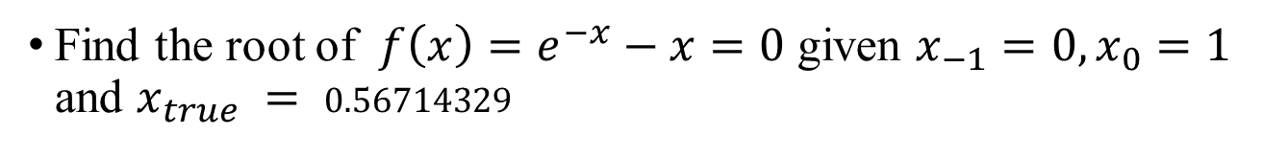
Problem: Secant Method
Find the root of $f\left(x\right)=e^{−x}−x=0$ given $x_{−1}=0,x_{0}=1$ and $x_{true} = 0.56714329$
$x_{i+1}= x_{i} − \frac{f\left(x_{i}\right) ∗ (x_{i−1}−x_{i})}{f\left(x_{i−1}\right)−f\left(x_{i}\right)}$

Slide 14
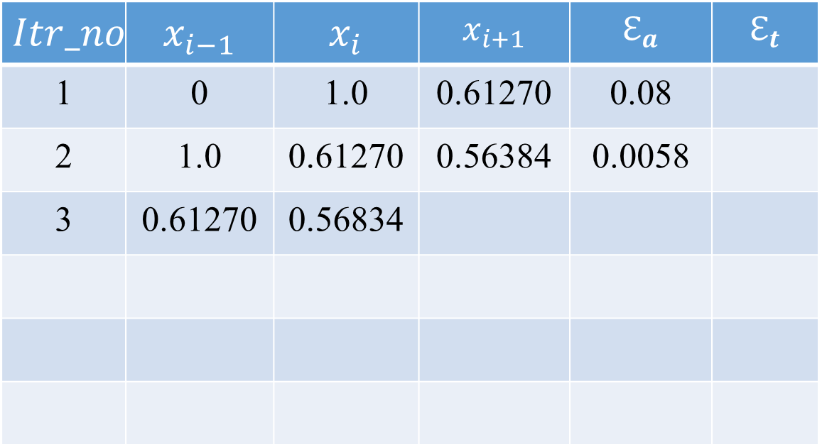
Problem: Secant Method
$$Itr_no$$ | $$x_{i−1}$$ | $$x_{i}$$ | $$x_{i+1}$$ | $$ℇ_{a}$$ | $$ℇ_{t}$$
1 | 0 | 1.0 | 0.61270 | 0.08
2 | 1.0 | 0.61270 | 0.56384 | 0.0058
3 | 0.61270 | 0.56834

Slide 15
Modified Secant method

Slide 16
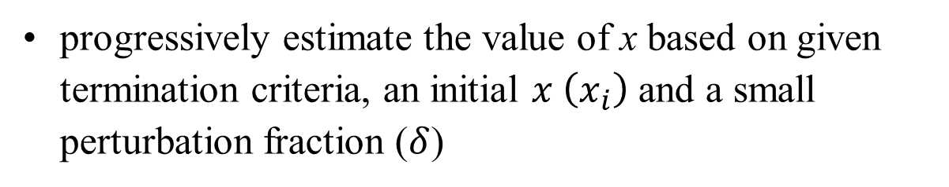
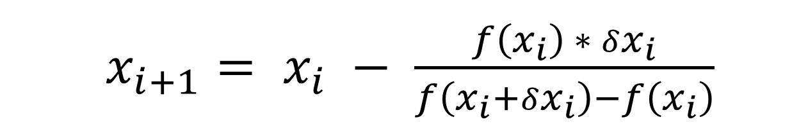
Algorithm: Modified Secant method
progressively estimate the value of x based on given termination criteria, an initial $x \left(x_{i}\right)$ and a small perturbation fraction ($δ$)
$x_{i+1}= x_{i} − \frac{f\left(x_{i}\right) ∗ δx_{i}}{f\left(x_{i}+δx_{i}\right)−f\left(x_{i}\right)}$

Slide 17
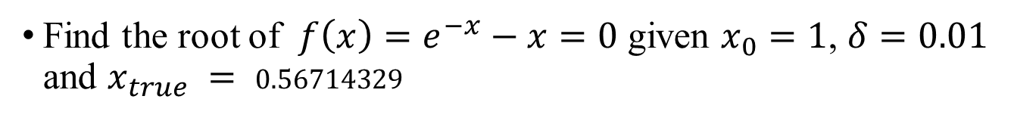
Problem: Modified Secant Method
Find the root of $f\left(x\right)=e^{−x}−x=0$ given $x_{0}=1$, $δ=0.01$ and $x_{true} = 0.56714329$
$x_{i+1}= x_{i} − \frac{f\left(x_{i}\right) ∗ (x_{i−1}−x_{i})}{f\left(x_{i−1}\right)−f\left(x_{i}\right)}$

Slide 18
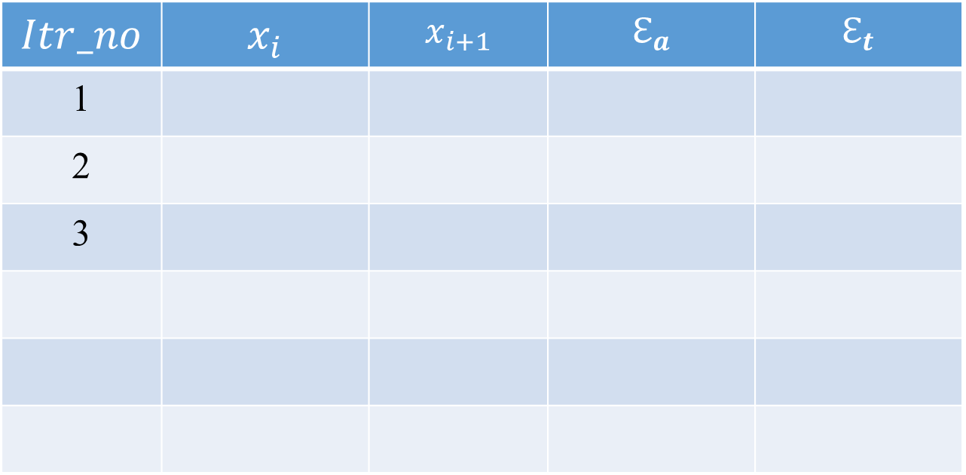
Problem: Modified Secant Method
$$Itr_no$$ | $$x_{i}$$ | $$x_{i+1}$$ | $$ℇ_{a}$$ | $$ℇ_{t}$$
1
2
3

